Slide 1
MIPS Simulator
By: Cole Estrin, Mercury Ruane, Eric Thompson,
Cesar Villarruel
Notes:
Cole: intro and readme

Slide 2
Sections
Overview of Simulator
File Parser and Decoder
Instruction Memory
Register file
Data memory
ALU
CPU Class and State Registers
Simulator, Debug Mode and demo
Notes:
Cole

Slide 3
Overview
Languages
Python for main program structure
HTML, CSS, JS for simulator web page components
MicroArchitecture resides in the same space
CPU.py puts everything together and runs the simulator.
Simulator web page to display content

Slide 4
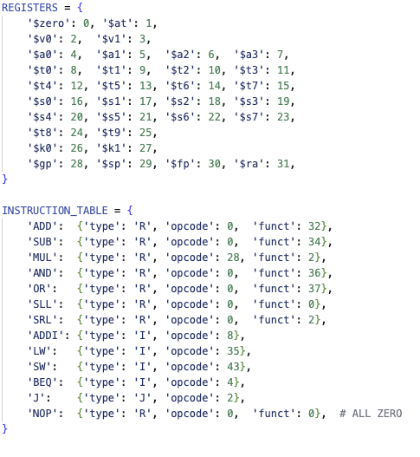
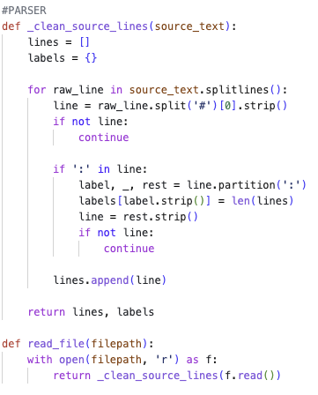
Parsing the File
Creates a register and instruction table containing register index, instruction types, and opcode
Reads source text
Clean the text by removing comments, blank lines, and separating labels
Removes anything after ( # ) to strip comments
Trims whitespace
Skips empty lines
Checks for labels ( : )
Stores labels in dictionary
Keeps the actual instructions text stored in ‘lines’
Notes:
Cesar

Slide 5
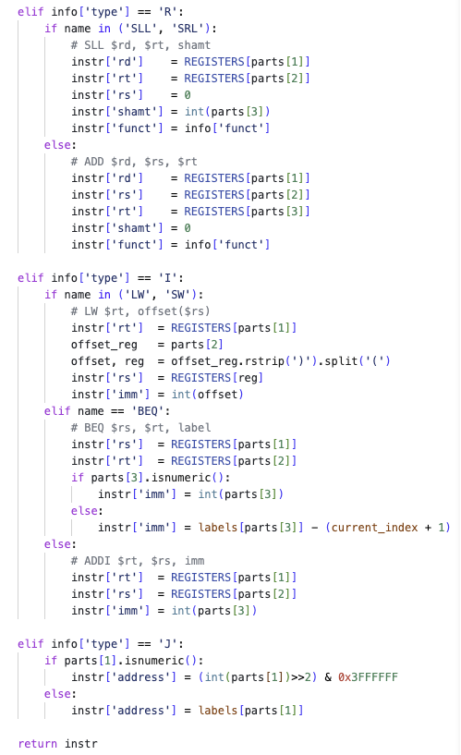
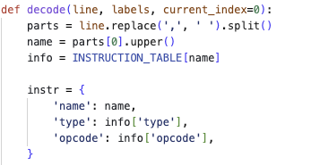
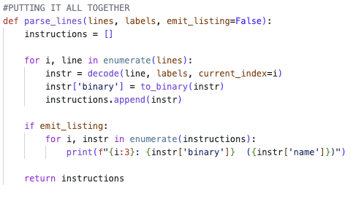
Decoding the File
Assembly gets turned into structured fields.
Tokenizes the line
Returns it into a structured format
Looks up instruction format in INSTRUCTION_TABLE
R, I, or J type
Builds a dictionary
Handles decoding based on instruction type
Register names are converted into their respective index based on the register dictionary
Converts instruction to binary
Builds final instruction list
Loops over every line, decodes, then appends to list
Notes:
Cesar

Slide 6
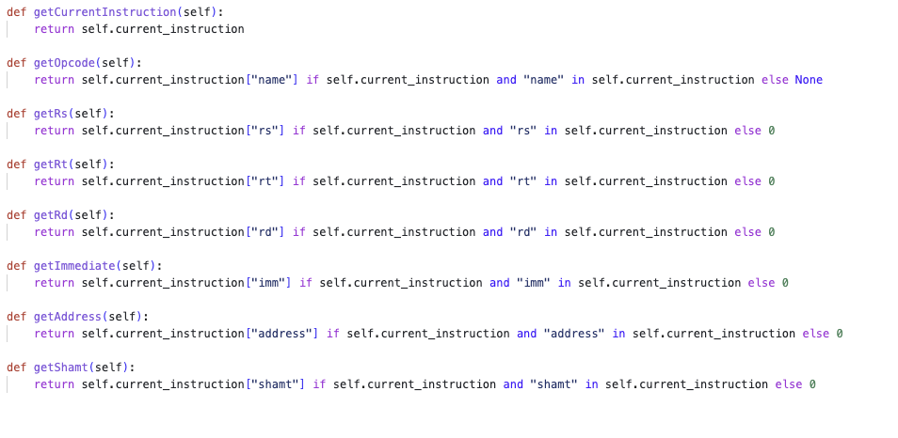
Instruction Memory
Takes the byte address from the CPU’s PC
Converts it to an instruction index
Loads instruction into self.current_instruction
Stores decoded list in self.instruction[ ]
CPU utilizes getter functions to read the fields from the fetched instructions.
Will safely return 0 or ‘none’ if there is no current instruction
Notes:
Eric

Slide 7
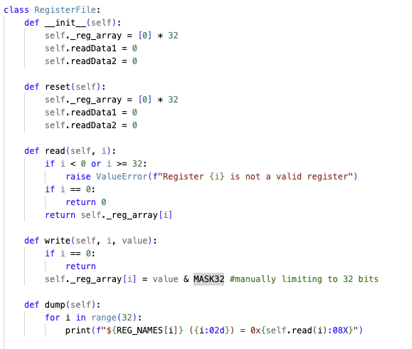
Register File
Array of 32 values for reg
read - returns value of register
write - limited to 32 bits
Notes:
Mercury

Slide 8
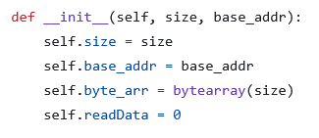
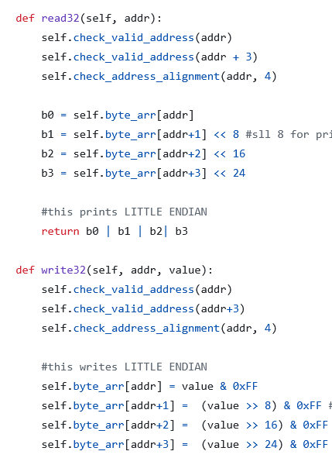
Data Memory
class declared with variable size
checks for address out of range/alignment
read32 returns bytes in little-endian order, shifting left for larger values
write32 does the same but writes to memory instead of returning
Also has read8 and write8 functions
Notes:
Mercury

Slide 9
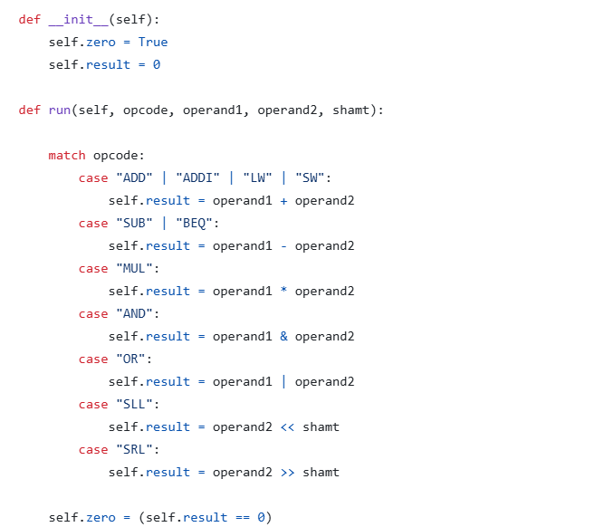
ALU Class
Checks which operand with match statement
Stores result in class
Sets flag when the result is zero for BEQ statements
Notes:
Eric

Slide 10
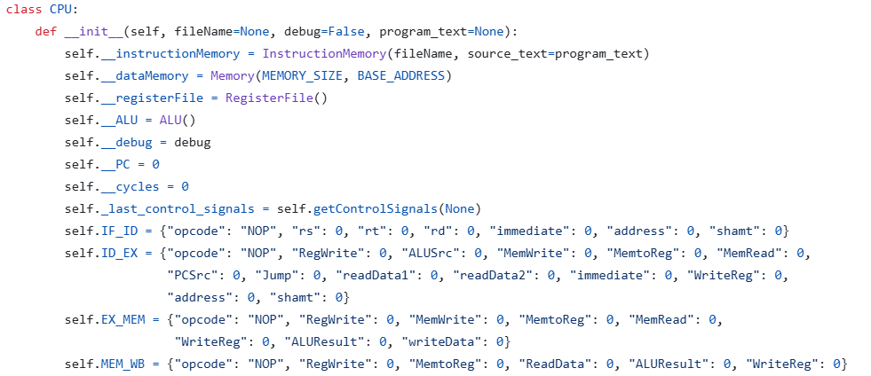
CPU Class
- Handles The connections between each component And controls when they are run
- Contains instances of the Instruction Memory, Register File, ALU, and Data Memory
- Holds the state registers stored as dictionaries
Notes:
Eric

Slide 11
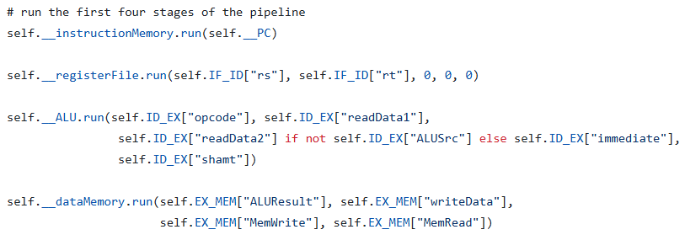
CPU Class main flow
- Gets the control signals of the current instruction
- Runs each component with the values from the state registers
- updates the program counter
- Updates the state register
- Finally run the write back of the register file
Notes:
Eric

Slide 12
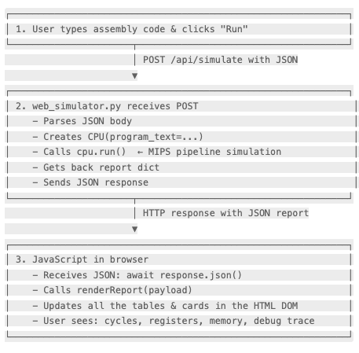
Simulator Website - How it works
HTML - UI contains:
.asm file dropdown
Text area for assembly input
Run button with a Debug checkbox
Output containers for registers, memory, and debug trace
Backend - Bridge between frontend and simulator
Browser “speaks” in HTTP so web page can’t communicate with python code directly.
Web server passes assembly source into the CPU through the backend then returns a report in JSON.
The returned report gets rendered as HTML elements on the web page for the user to browse.
Notes:
Cesar

Slide 13
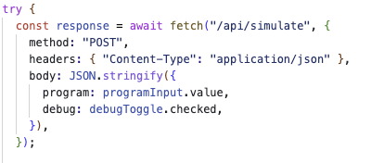
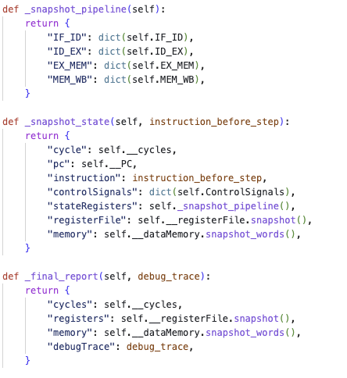
Debug Mode
Debug mode makes the simulator record a snapshot after every cycle.
When you check the Debug option -> toggles Debug to True
Creates array of per-cycle snapshot from functions in CPU.py
Each cycle returns control signals and state register content.
The web page then displays control signals and state registers
The returned snapshot contains:
Cycle: current cycle counter
PC: current program counter
Instruction: fetched instruction
controlSignals: tracked signals
stateRegisters: dictionary of pipeline registers
Memory: full memory word state
Notes:
Cesar

Slide 14
Simulator Demo

